Slide 1
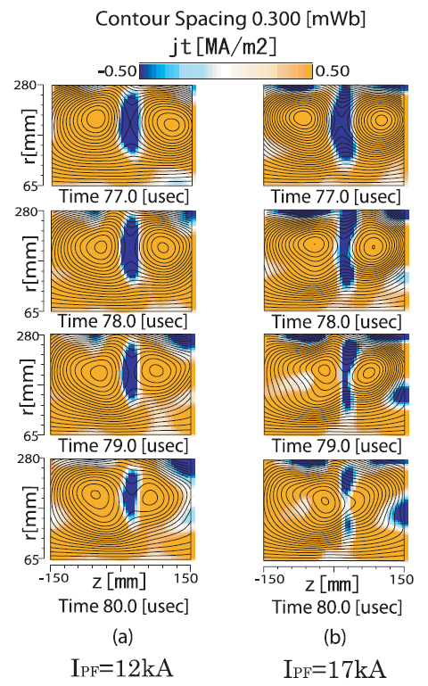
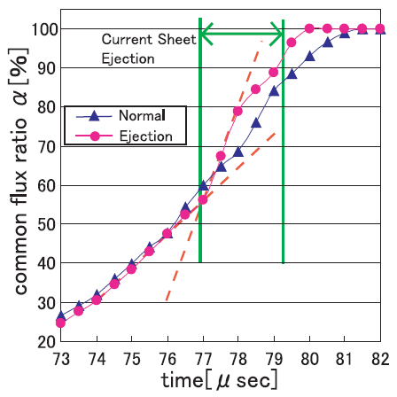
(i)
(ii)

Slide 2
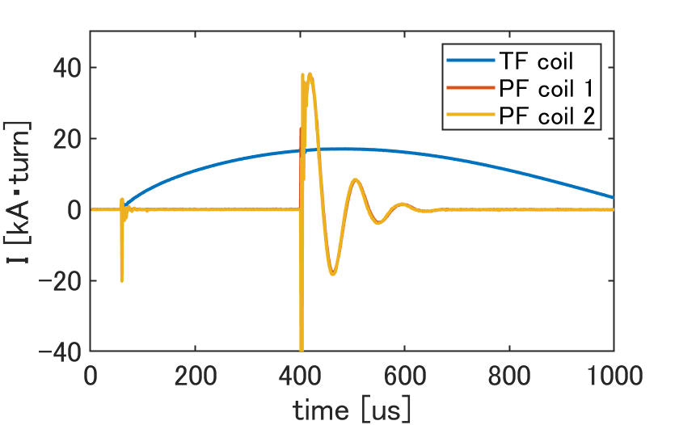
2.1 ロゴスキーコイル波形（全体＋PF拡大）

Slide 3
2.1 TS-6断面図

Slide 4
2.1 PFコイル立ち上げの磁力線

Slide 5
2.2 ロゴスキーコイル

Slide 6
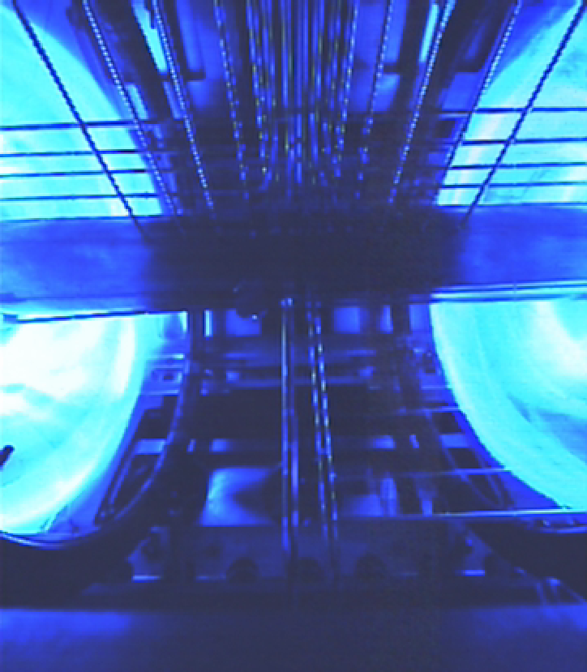
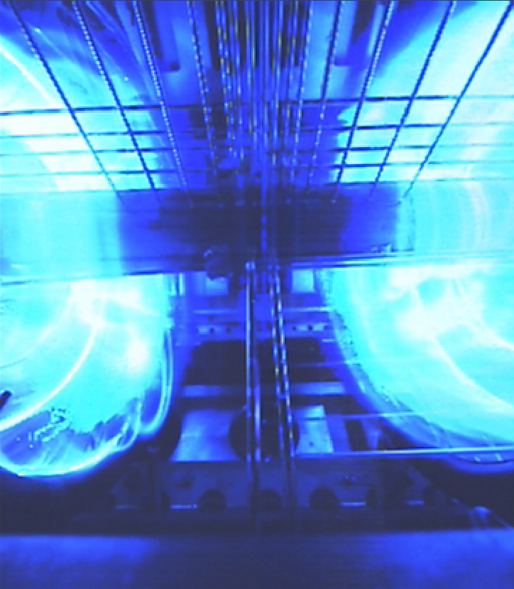
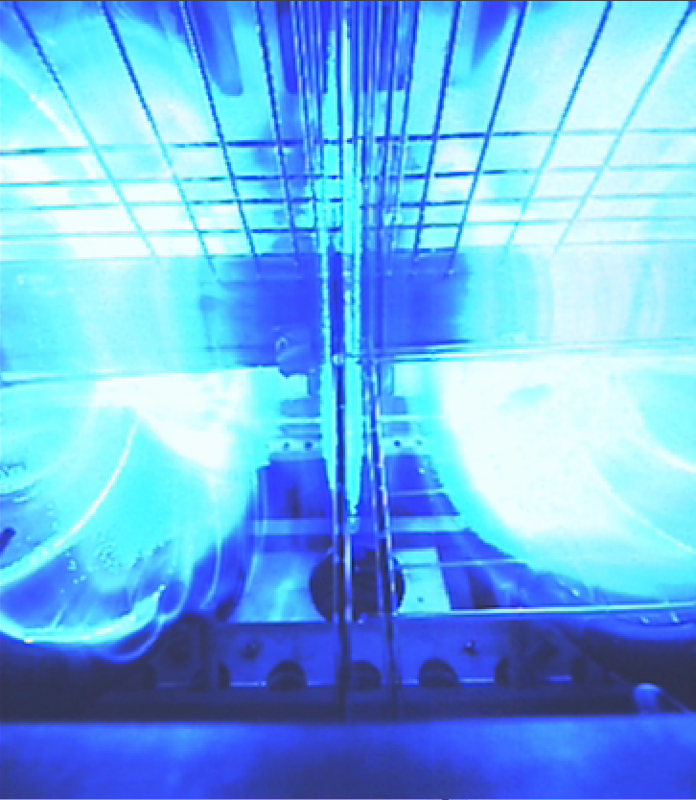
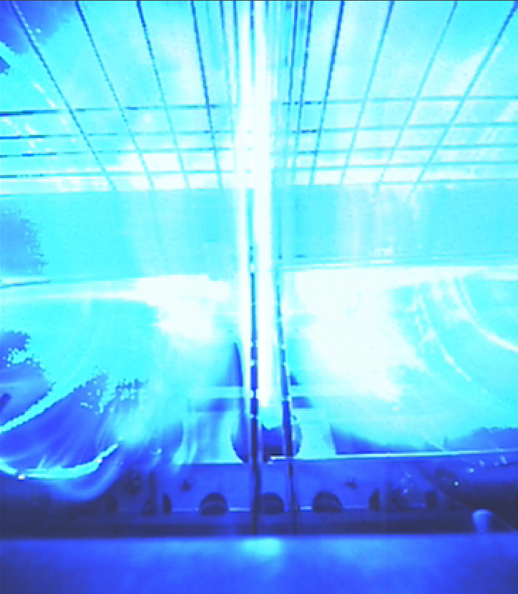
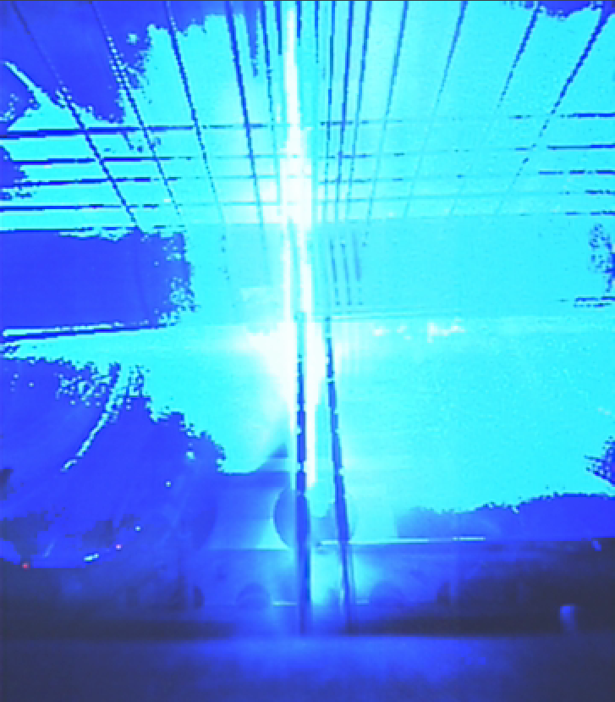
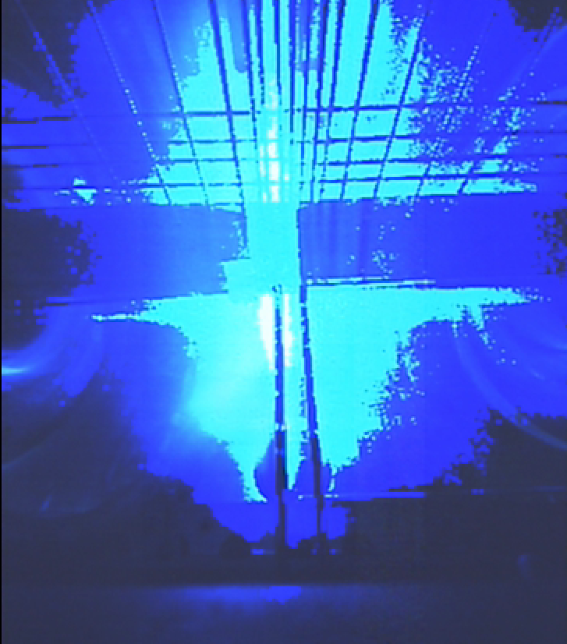
高速度カメラ
(1)
(2)
(3)
(4)
(5)
(6)

Slide 7
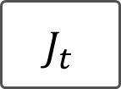
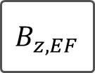
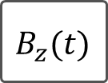
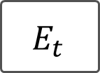
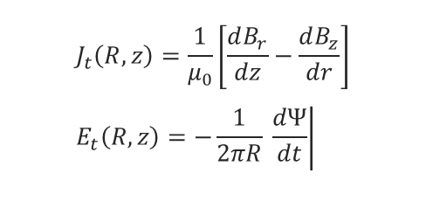

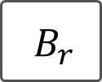


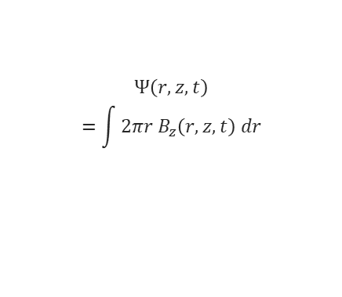
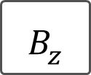
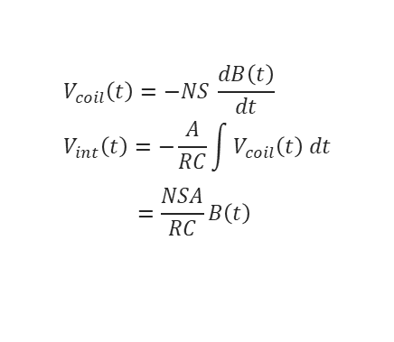
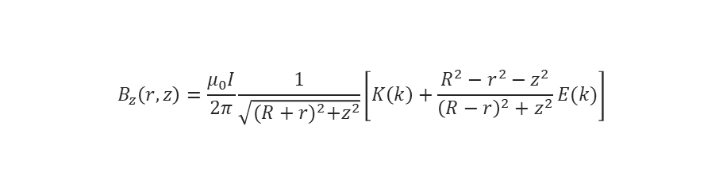
磁場計測原理
積分増幅回路
軸対称性
$${ V}_{coil}$$
$${ B}_{z}(t)$$
$$B_{z}$$
$$Ψ$$
$${ B}_{r}$$
$$V_{coil}\left(t\right)=−NS \frac{dB\left(t\right)}{dt} \\ V_{int}\left(t\right)=−\frac{A}{RC}\int{V_{coil}\left(t\right) dt} \\ =\frac{NSA}{RC}B\left(t\right)$$
$$B_{r}=−\frac{1}{2πr}\frac{∂Ψ}{∂z}$$
$$Ψ\left(r,z,t\right)$$
$$=\int{2πr B_{z}\left(r,z,t\right) dr}$$
$$J_{t}\left(R,z\right)=\frac{1}{μ_{0}}\left[\frac{dB_{r}}{dz}−\frac{dB_{z}}{dr}\right] \\ E_{t}\left(R,z\right)=−\frac{1}{2πR} \left.\frac{dΨ}{dt}\right|$$
$${ B}_{z,EF}$$
v
r=R
$$B_{z}\left(r,z\right)=\frac{μ_{0}I}{2π}\frac{1}{\sqrt{{(R+r)}^{2}+z^{2}}}\left[K\left(k\right)+\frac{R^{2}−r^{2}−z^{2}}{{\left(R−r\right)}^{2}+z^{2}}E(k)\right]$$
平衡磁場（直流成分）
r=R
$${ E}_{t}$$
$${ J}_{t}$$

Slide 8
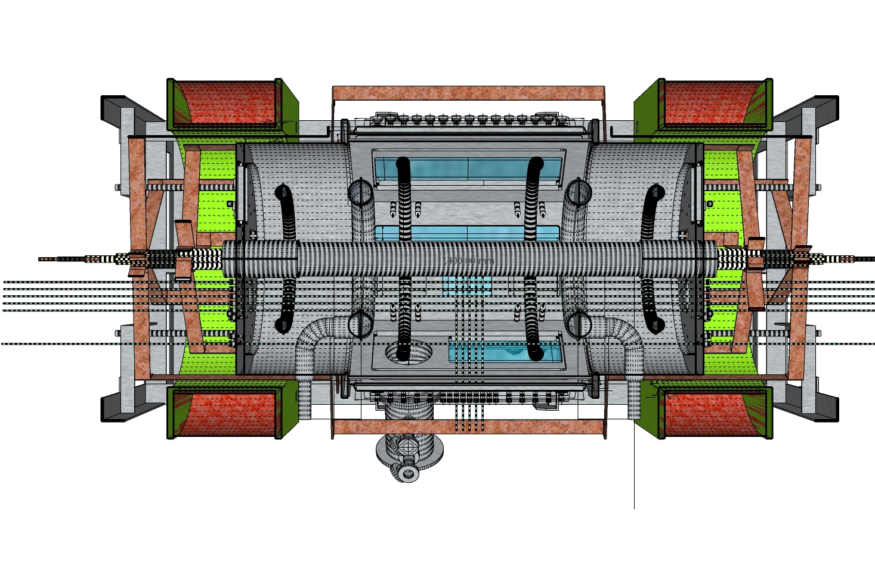
磁場計測点
1.44 m
0.75 m

Slide 9
磁場計測点
r=0.3m z=0.2135m
r=0.22m z=0.35m
1.44 m
EF Coil
PCB-type probe
0.75 m
Separation Coil
Pickup coil
R= 0.075, 0.121, 0.167, 0.220, 0.250, 0.275 m
Hand rolled type probe
Flux Core PF Coil
r
z
θ
Central TF Coil

Slide 10
磁場計測点
EF Coil
PCB-type probe
Separation Coil
Flux Core PF Coil
r
z
θ
Central TF Coil

Slide 11
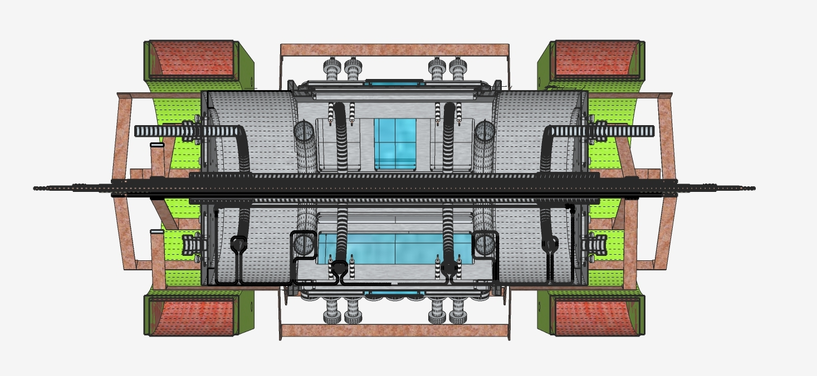
PF Coil
EF Coil
TF Coil
Separation Coil
Flux Core Coil

Slide 12
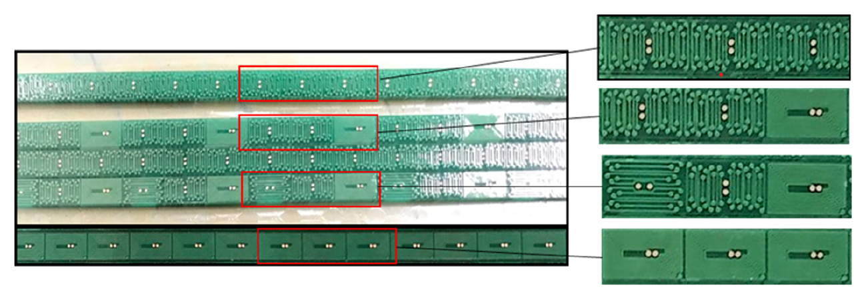

Slide 13
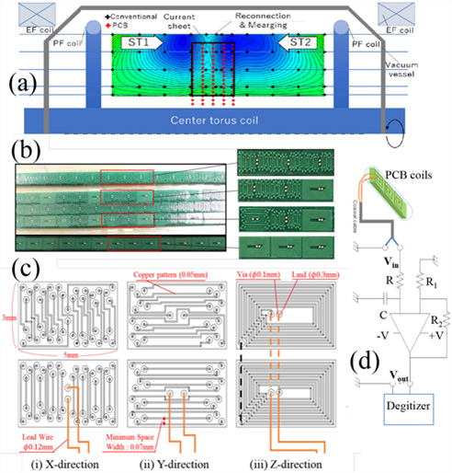

Slide 14
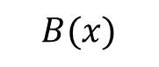
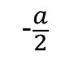
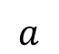
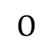
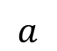


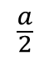
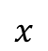
Helmholtzコイル
Function generator
$$I$$
$$a$$
$$a$$
$$I$$
$$B(x)$$
$$−\frac{a}{2}$$
$$O$$
$$\frac{a}{2}$$
$$x$$

Slide 15
Helmholtzコイル理論式

Slide 16

outflow
current sheet
$$j_{t}$$
X point
inflow

Slide 17
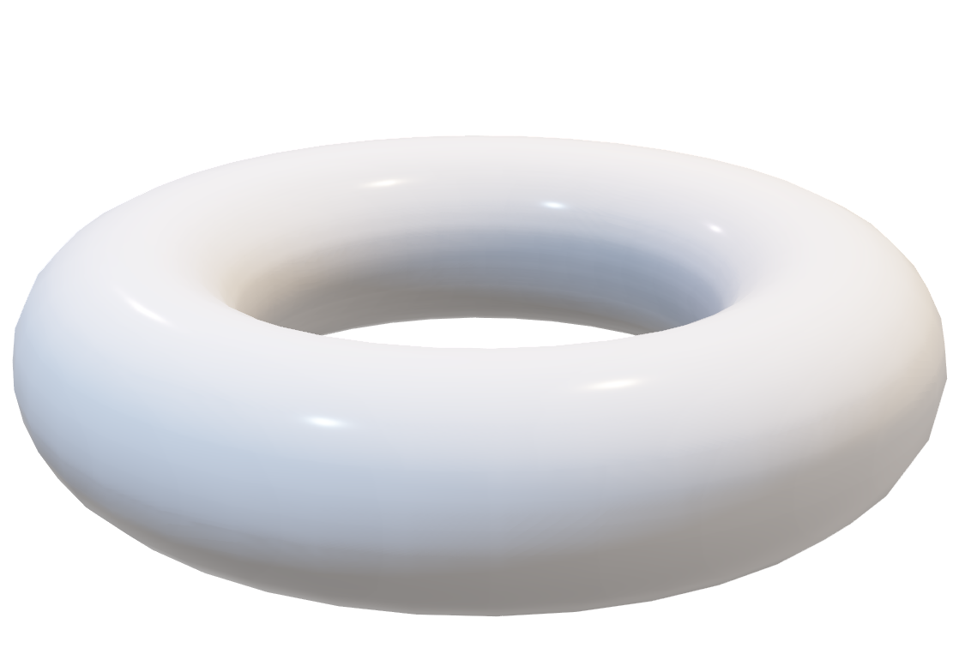


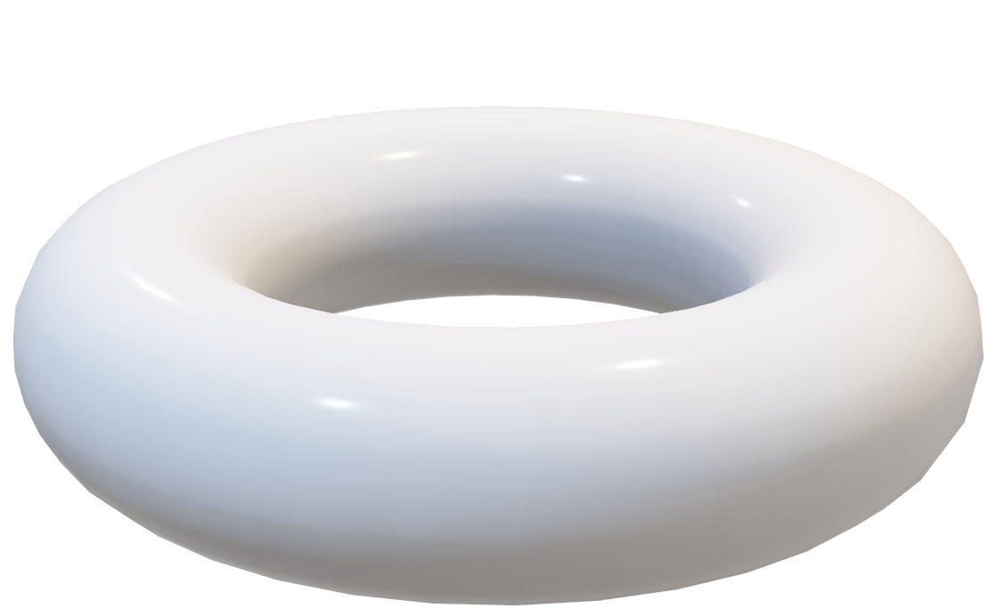
(a)
outflow
(b)
$Ψ$ (poloidal flux)
r
inflow
X point
inflow
$$I$$
θ
0
z
current sheet
r
plasma
z
θ

Slide 18




outflow
$$v_{out}$$
$$δ$$
inflow
$$L$$
$$j_{t}$$
$$v_{in}$$
current sheet

Slide 19
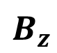
プローブ模式図
digitizer
真空容器
$$B_{z}$$
ガラス管に入った
磁気プローブ
・・・

Slide 20
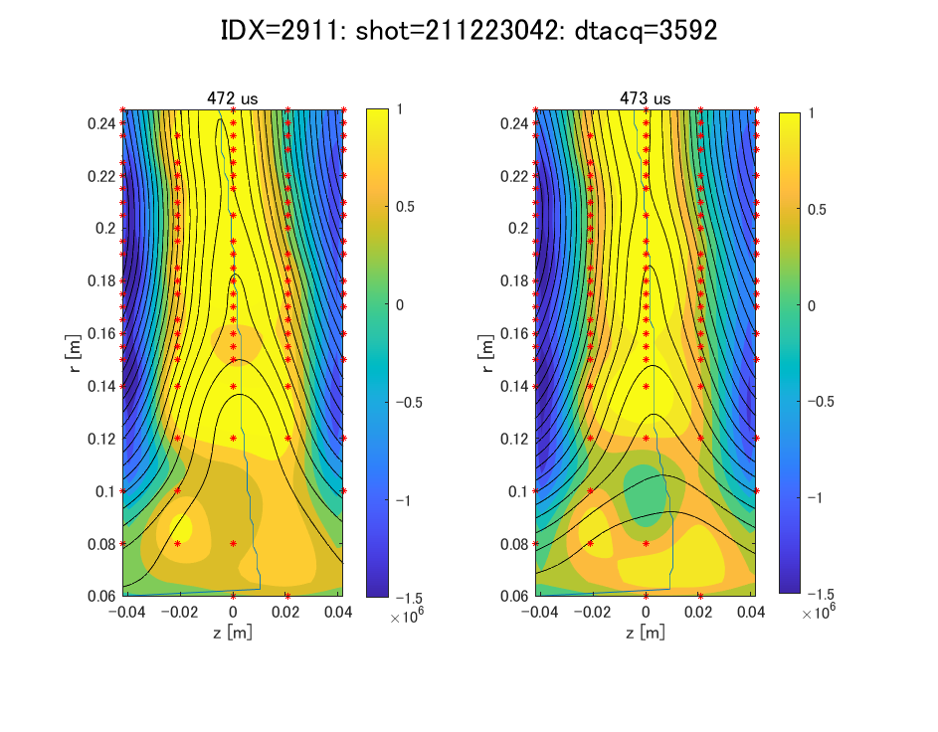
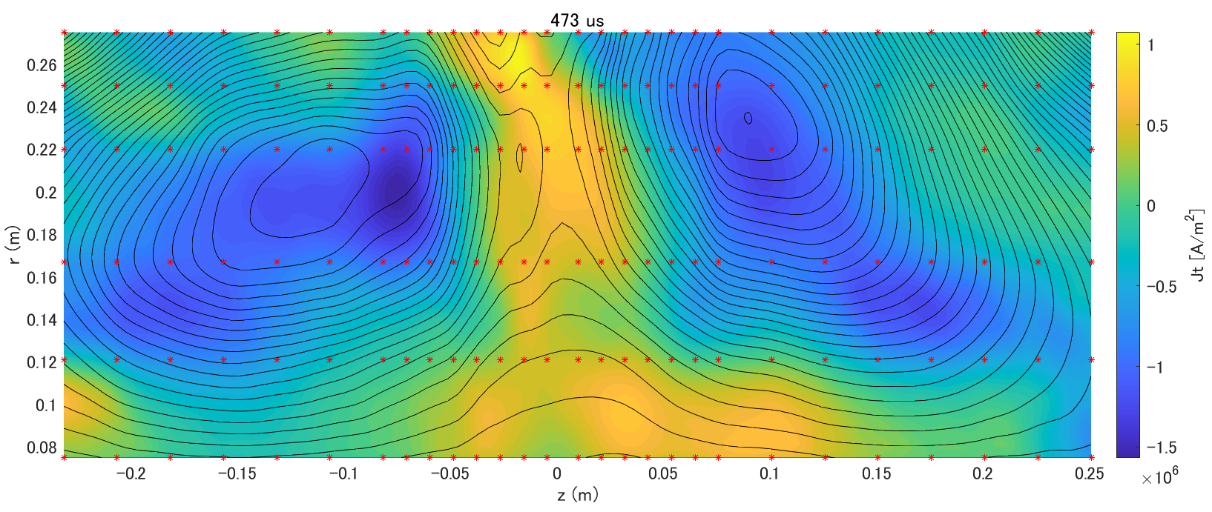
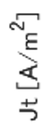
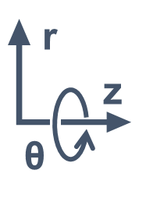
計測範囲
ー 黒線：R-Z平面におけるポロイダル磁気面 カラー面：紙面垂直なトロイダル電流密度 Jt
＊赤印：計測点

Slide 21
TF・PF真空磁場ショットの生信号

Slide 22
TFオフセット差し引きの信号変化

Slide 23
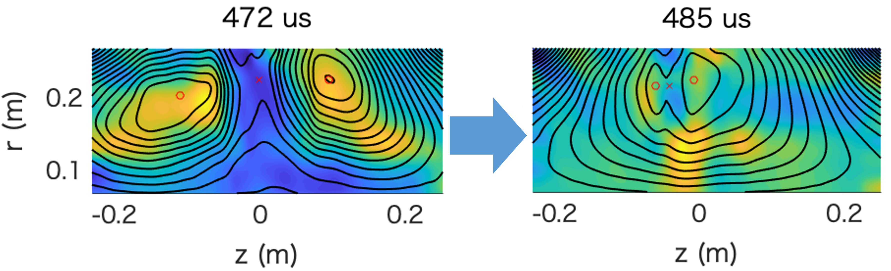
IDX2911：全体の磁気面
t= [μs]

Slide 24
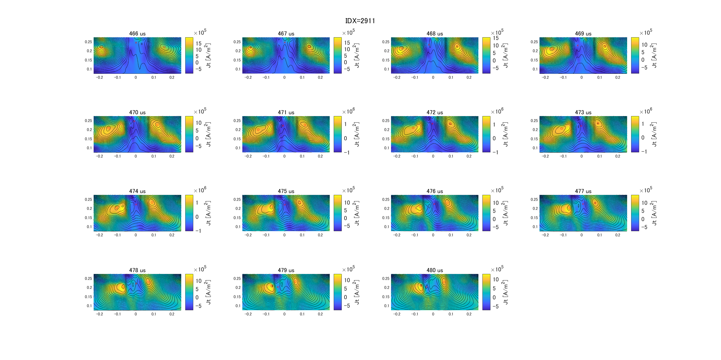

Slide 25
7 μs
9 μs
r [m]
z [m]
z [m]
11 μs
13 μs
r [m]
z [m]
z [m]

Slide 26
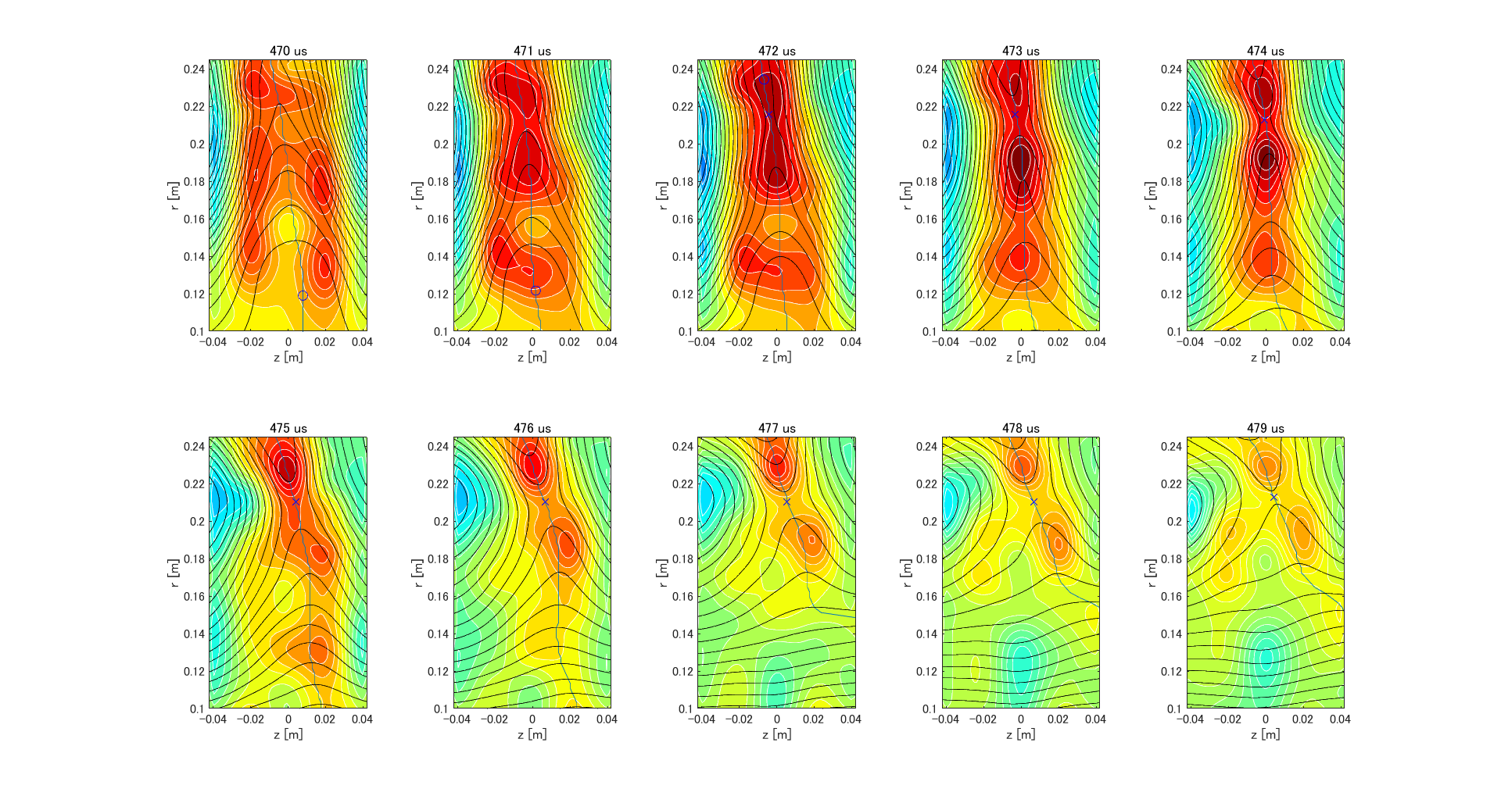
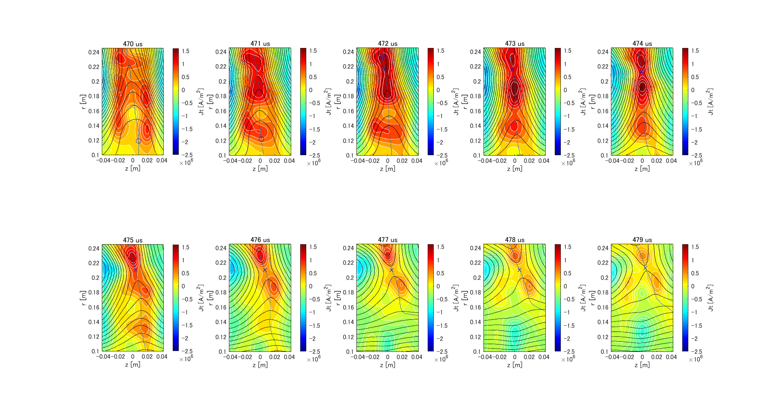
9 μs
9 μs
r [m]
r [m]
z [m]
z [m]

Slide 27
7 μs
9 μs
r [m]
z [m]
z [m]
11 μs
13 μs
r [m]
z [m]
z [m]

Slide 28
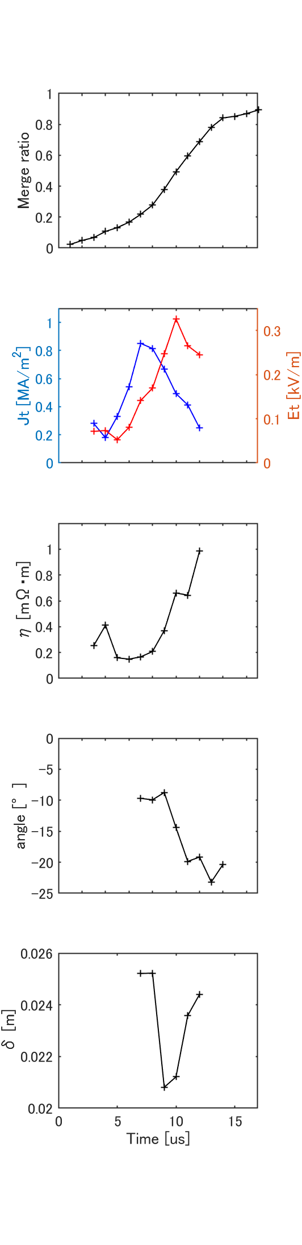
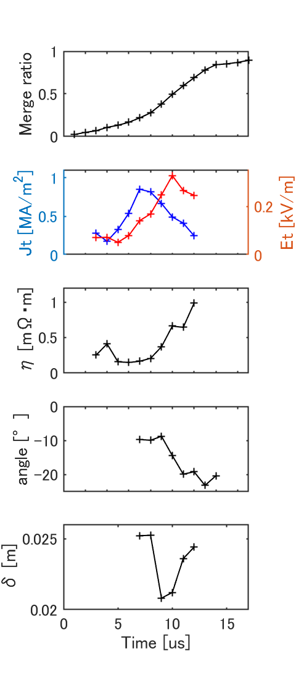
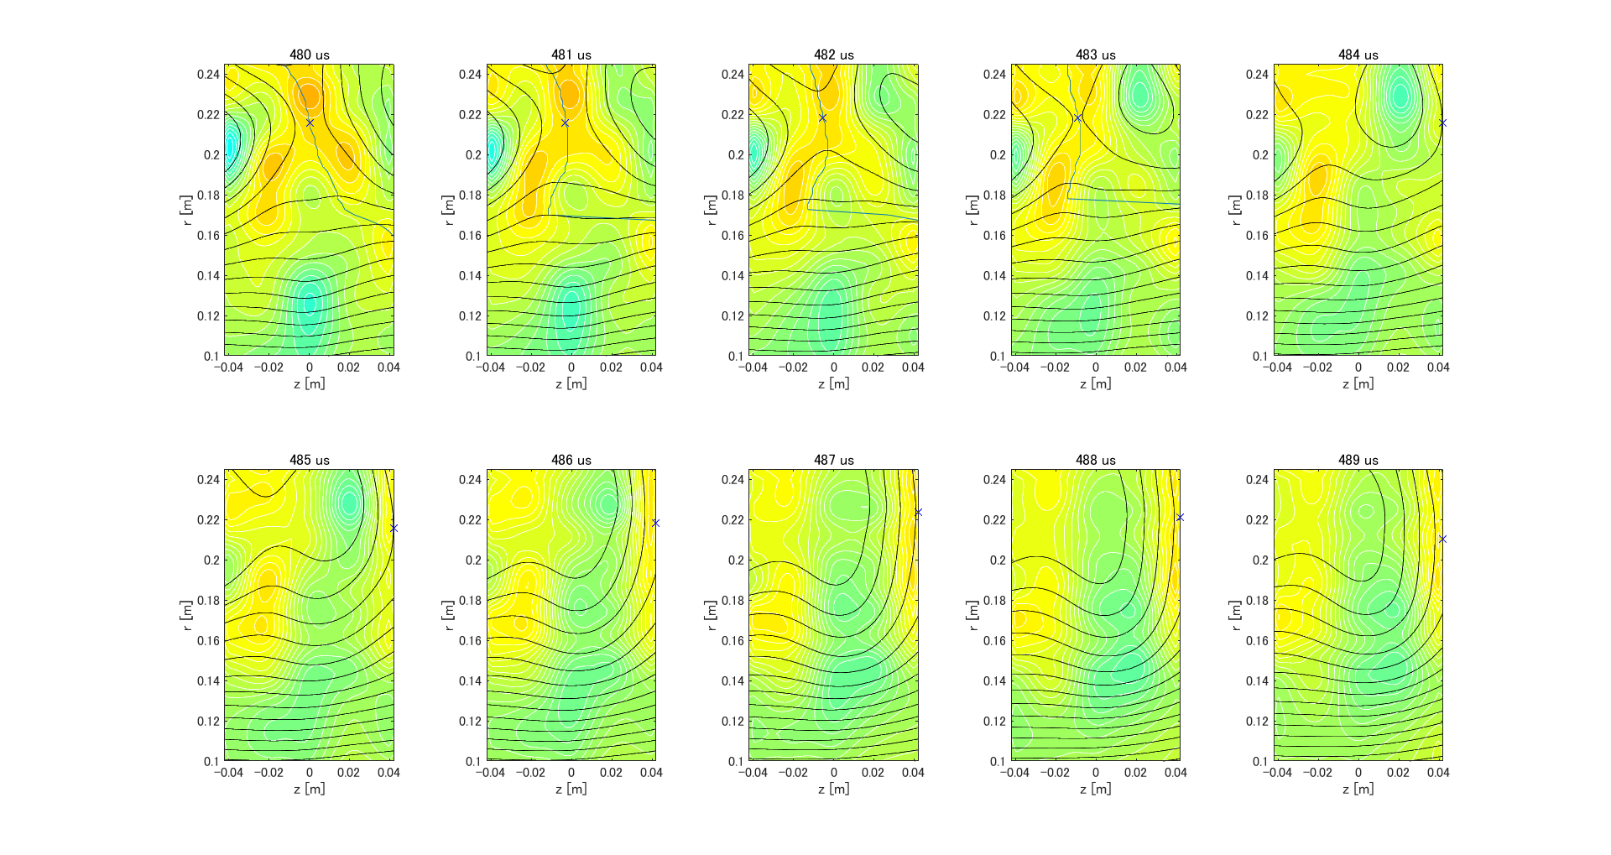
(a)
3 blobs
reduction
(b)
3 blobs
a thin sheet
2 blobs
7 μs
8 μs
9 μs
10 μs
2 blobs
11 μs
12 μs
13 μs
14 μs
15 μs
Time [μs]

Slide 29
3 blobs
7 μs
8 μs
9 μs
10 μs
2 blobs
11 μs
12 μs
13 μs
14 μs
15 μs

Slide 30
3 blobs
reduction
a thin sheet
2 blobs
Time [μs]

Slide 31
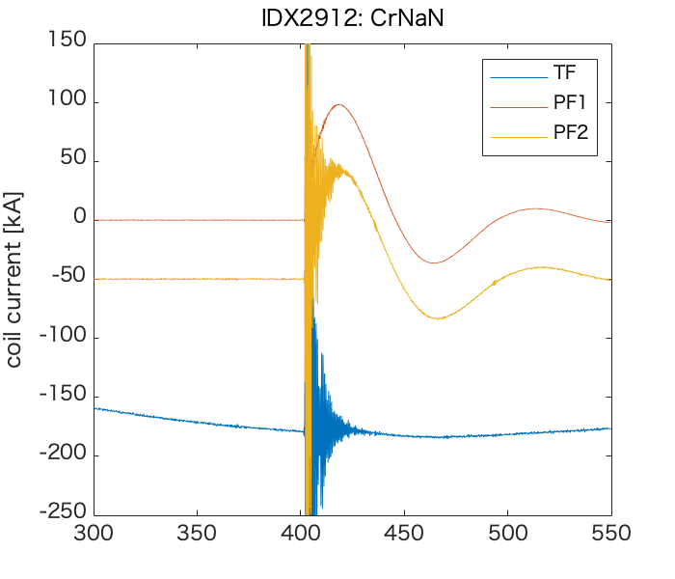
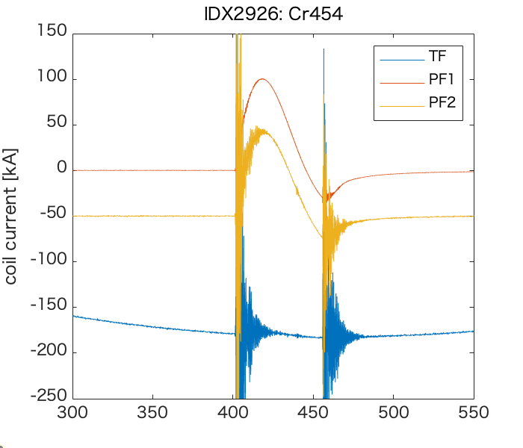
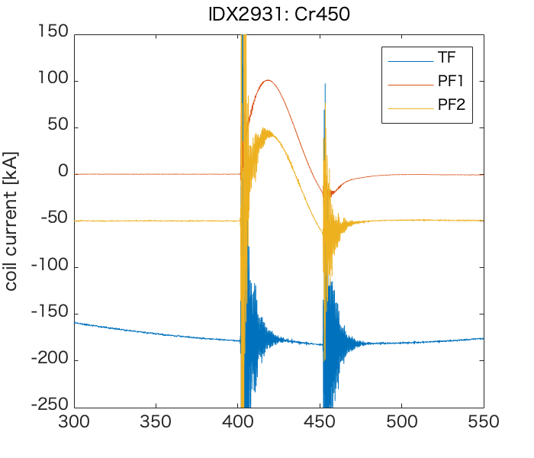
(a)
(b)
(c)
t= [μs]
t= [μs]
t= [μs]

Slide 32
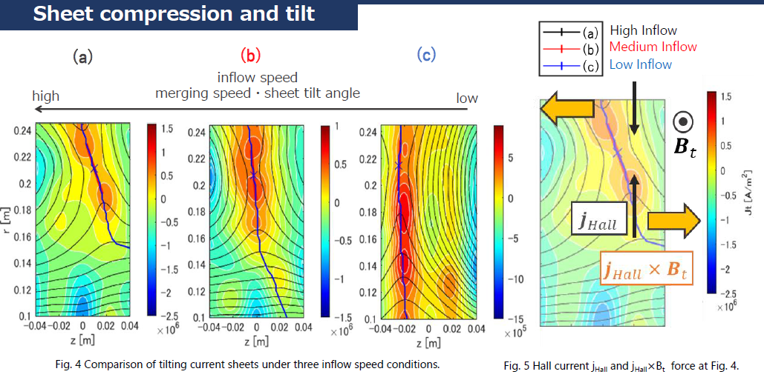

Slide 33
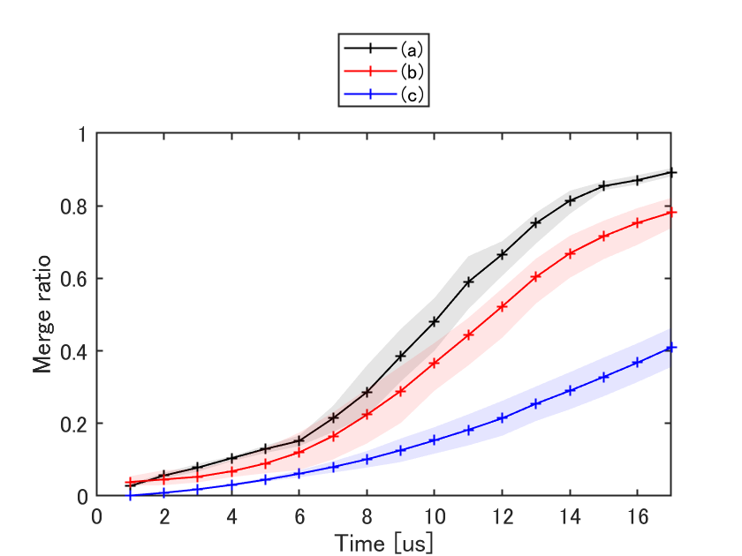
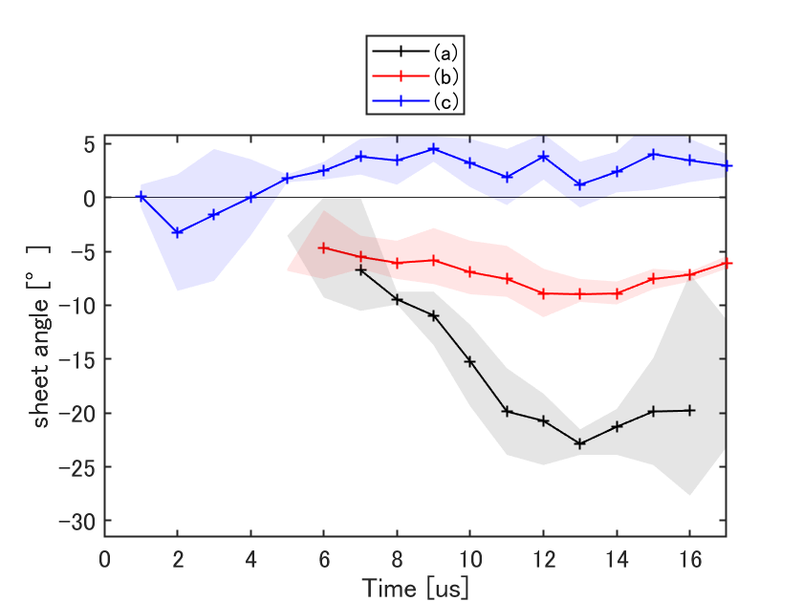

Slide 34


Slide 35
シート幅計算手法 z-Br

Slide 36

413:TF 4kV

Slide 37


413:TF 4kV
r [m]
J_{t} [A/m²]
r [m]
z [m]

Slide 38
PF10us遅れのロゴスキー波形

Slide 39



433:-4kV 10us遅れ
r [m]
J_{t} [A/m²]
r [m]
r [m]
z [m]

Slide 40
433:-4kV 10us遅れ
r [m]
J_{t} [A/m²]
r [m]
r [m]
r [m]
r [m]
z [m]

Slide 41





23011114
Stage1
Stage2
Jt [A/m²]
r [m]
z [m]
r [m]
z [m]

Slide 42
23011114
Stage1
Stage2
Jt [A/m²]
r [m]
z [m]
r [m]
z [m]

Slide 43
Stage1
Stage2

Slide 44

r [m]
z [m]
Jt [A/m²]
r [m]
z [m]

Slide 45

Stage1
Stage2

Slide 46



Jt [A/m²]

Slide 47
Jt [A/m²]
r [m]
z [m]
Notes:
Ｃｒありの合体遅いときといまのおぺれーしょんでは合体速度は同じ
Brecやガイド磁場は

Slide 48
インフロー駆動位置
plasma
427 mm
600 mm
700 mm

Slide 49
ブロブ生成による高速化
Time 7 μs
Time 8 μs
Time 10 μs
a thin sheet
3
blobs
2
blobs
reduction
a thin sheet
3 blobs
Time 12 μs
Time 14 μs
Time 15 μs
Anonymous Resistivity
←Spitzer Resistivity
Time [μs]
2 blobs
reduction

Slide 50
プラズモイド生成による高速化
r [m]
r [m]
Jt [A/m²]
←Spitzer Resistivity
z [m]

Slide 51
シート放出による高速化
r [m]
z [m]
Jt [A/m²]

